Slide 1
UNIT-II

Slide 2
Encryption
Encryption techniques are as old as the practice of sending and receiving messages.
The sender encrypts a message by translating it to a secret code, called a cipher text.
At the other end, the receiver decrypts the cipher text back to its original plaintext form.
Both parties to this transaction must have at their disposal one or more keys that allow them to encrypt and decrypt messages.

Slide 3
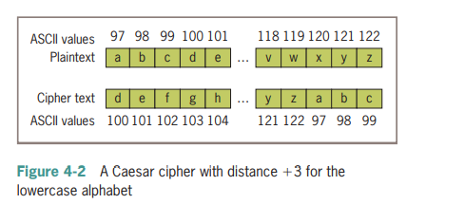
Contd..
A very simple encryption method that has been in use for thousands of years is called a Caesar cipher.
This encryption strategy replaces each character in the plaintext with the character that occurs a given distance away in the sequence.
Caesar cipher equals three characters, the string "invaders" would be encrypted as "lqydghuv".
To decrypt this cipher text back to plaintext, you apply a method that uses the same distance value but looks to the left of each character for its replacement.

Slide 4
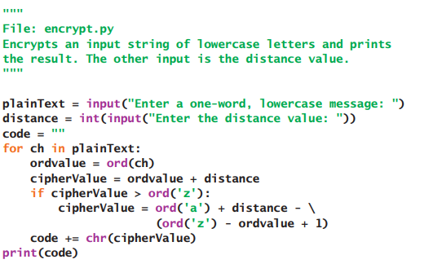
Encryption Using Python
Enter a one-word, lowercase message: invaders Enter the distance value: 3
o/p:
lqydghuv

Slide 5
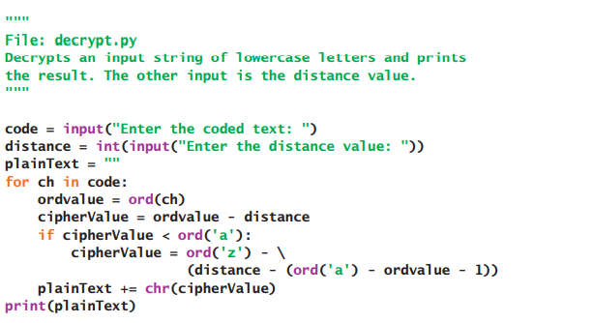
Decryption Using Python
Enter the coded text: lqydghuv
Enter the distance value: 3
o/p
invaders

Slide 6
Write the encrypted text of each of the following words using a Caesar cipher with a distance value of 3:
a. python
b. hacker
c. wow

Slide 7
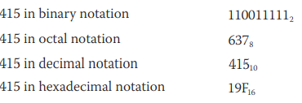
Strings and Number Systems
decimal number system - base ten number system - 0-9
binary number system - base two number system - 0,1
Octal - base eight - 0-7
hexadecimal - base 16 - 0-15

Slide 8
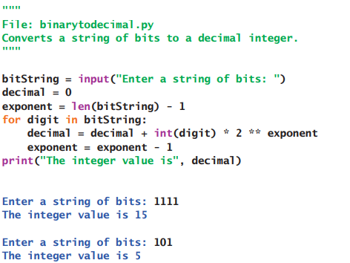
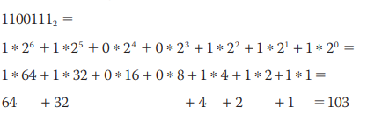
Converting Binary to Decimal

Slide 9
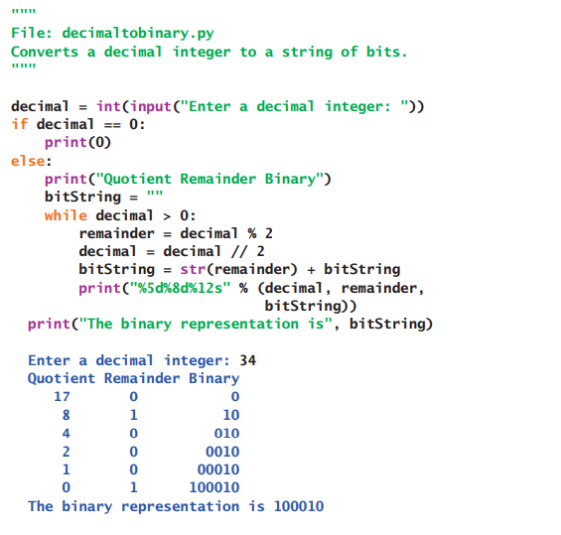
Converting Decimal to Binary

Slide 10
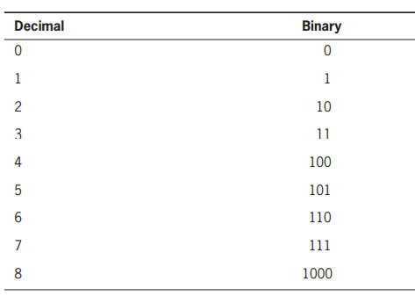
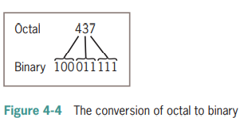
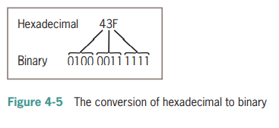
Octal and Hexadecimal Numbers

Slide 11
Python Strings:
Strings in Python are identified as a contiguous set of characters represented in the quotation marks. Python allows for either pairs of single or double quotes. Subsets of strings can be taken using the slice operator ([ ] and [:] ) with indexes starting at 0 in the beginning of the string and working their way from -1 at the end.
The plus (+) sign is the string concatenation operator and the asterisk (*) is the repetition operator. For example:
Program:
str ="WELCOME"
print str # Prints complete string
print str[0] # Prints first character of the string
print str[2:5] # Prints characters starting from 3rd to 5th print str[2:] # Prints string starting from 3rd character print str * 2 # Prints string two times
print str + "CSE" # Prints concatenated string
Output:
WELCOME W
LCO LCOME
WELCOMEWELCOME WELCOMECSE

Slide 12
SNO | Method Name | Description
1 | capitalize() | Capitalizes first letter of string.
2 | center(width, fillchar) | Returns a space-padded string with the original string centered to a total of width columns.
3 | count(str, beg= 0,end=len(string)) | Counts how many times str occurs in string or in a substring of string if starting index beg and ending index end are given.
4 | decode(encoding='UTF- 8',errors='strict') | Decodes the string using the codec registered for encoding. Encoding defaults to the default string encoding.
5 | encode(encoding='UTF- 8',errors='strict') | Returns encoded string version of string; on error, default is to raise a Value Error unless errors is given with 'ignore' or 'replace'.
6 | endswith(suffix, beg=0, end=len(string)) | Determines if string or a substring of string (if starting index beg and ending index end are given) ends with suffix; returns true if so and false otherwise.
7 | expandtabs(tabsize=8) | Expands tabs in string to multiple spaces; defaults to 8 spaces per tab if tabsize not provided.
8 | find(str, beg=0 end=len(string)) | Determine if str occurs in string or in a substring of string if starting index beg and ending index end are given returns index if found and -1 otherwise.

Slide 13
9 | index(str, beg=0, end=len(string)) | Same as find(), but raises an exception if str not found.
10 | isalnum() | Returns true if string has at least 1 character and all characters are alphanumeric and false otherwise.
11 | isalpha() | Returns true if string has at least 1 character and all characters are alphabetic and false otherwise.
12 | isdigit() | Returns true if string contains only digits and false otherwise.
13 | islower() | Returns true if string has at least 1 cased character and all cased characters are in lowercase and false otherwise.
14 | isnumeric() | Returns true if a unicode string contains only numeric characters and false otherwise.
15 | isspace() | Returns true if string contains only whitespace characters and false otherwise.
16 | istitle() | Returns true if string is properly "titlecased" and false otherwise.
17 | isupper() | Returns true if string has at least one cased character and all cased characters are in uppercase and false otherwise.
18 | join(seq) | Merges (concatenates) the string representations of elements in sequence seq into a string, with separator string.
19 | len(string) | Returns the length of the string.
20 | ljust(width[, fillchar]) | Returns a space-padded string with the original string left-justified to a total of width columns.
21 | lower() | Converts all uppercase letters in string to lowercase.
22 | lstrip() | Removes all leading whitespace in string.
23 | maketrans() | Returns a translation table to be used in translates function.
24 | max(str) | Returns the max alphabetical character from the string str.

Slide 14
33 | startswith(str, beg=0,end=len(string)) | Determines if string or a substring of string (if starting index beg and ending index end are given) starts with substring str; returns true if so and false otherwise.
34 | strip([chars]) | Performs both lstrip() and rstrip() on string.
35 | swapcase() | Inverts case for all letters in string.
36 | title() | Returns "titlecased" version of string, that is, all words begin with uppercase and the rest are lowercase.
37 | translate(table, deletechars="") | Translates string according to translation table str(256 chars), removing those in the del string.
38 | upper() | Converts lowercase letters in string to uppercase.
39 | zfill (width) | Returns original string leftpadded with zeros to a total of width characters; intended for numbers, zfill() retains any sign given (less one zero).
40 | isdecimal() | Returns true if a unicode string contains only decimal characters and false otherwise.

Slide 15
25 | min(str) | Returns min alphabetical character from the string str.
26 | replace(old, new [, max]) | Replaces all occurrences of old in string with new or at most max occurrences if max given.
27 | rfind(str, beg=0,end=len(string)) | Same as find(), but search backwards in string.
28 | rindex( str, beg=0, end=len(string)) | Same as index(), but search backwards in string.
29 | rjust(width,[, fillchar]) | Returns a space-padded string with the original string right-justified to a total of width columns.
30 | rstrip() | Removes all trailing whitespace of string.
31 | split(str="", num=string.count(str)) | Splits string according to delimiter str (space if not provided) and returns list of substrings; split into at most num substrings if given.
32 | splitlines ( num=string.count('\n')) | Splits string at all (or num) NEWLINEs and returns a list of each line with NEWLINEs removed.

Slide 16
Text Files
Using a text editor such as Notepad or TextEdit, you can create, view, and save data in a text file
Python programs can output data to a text file
The data in a text file can be viewed as characters, words, numbers, or lines of text, depending on the text file’s format and on the purposes for which the data are used.

Slide 17
Writing Text to a File
Data can be output to a text file using a file object.
Python’s open function, which expects a file name and a mode string as arguments, opens a connection to the file on disk and returns a file object.
The mode string is 'r' for input files and 'w' for output files.
Thus, the following code opens a file object on a file named myfile.txt for output
>>> f = open("myfile.txt", ‘w’)
>>> f.write("First line.\nSecond line.\n“)
>>> f.close()

Slide 18
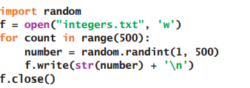
Writing Numbers to a File

Slide 19
Reading Text from a File
You open a file for input in a similar manner to opening a file for output.
The only thing that changes is the mode string, which, in the case of opening a file for input, is 'r’.
However, if a file with that name is not accessible, Python raises an error.
Here is the code for opening myfile.txt for input
>>> f = open("myfile.txt", ‘r’)
>>> text = f.read()
>>> text
'First line.\nSecond line.\n’
>>> print(text)
First line.
Second line.

Slide 20
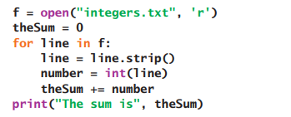
Reading Numbers from a File

Slide 21
